Slide 1

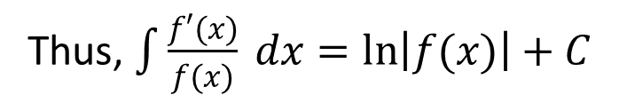


1.1.2 Integration by Substitution
If $u=g(x)$ is a differentiable function whose range is an interval $I$ and $f(x)$ is continuous on $I$ then
$$∫f\left(g\left(x\right)\right)g^{′}\left(x\right)dx=∫f(u)du$$
Where If $u=g(x)$ then $du=g^{′}\left(x\right)dx$
An integral of the form$\int{\frac{f′(x)}{f(x)} dx}$
Thus, $\int{\frac{f′(x)}{f(x)} dx=\ln\left|f(x)\right|+C}$

Slide 2
Example set 1.1.2
1.
2.

Slide 3
3.
4.

Slide 4
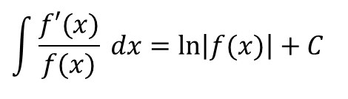
5.
$$\int{\frac{f′(x)}{f(x)} dx=\ln\left|f(x)\right|+C}$$
6.
7.
8.
9.

Slide 5

Exercise set-1.1.3
.
$(a)\int{\frac{1}{x+2}dx}$, (b) $\int{\frac{3x^{2}+2}{x^{3}+2x}dx}$, (c) $\int{\frac{2x−1}{x^{2}−x+3}dx}$,
(d) $\int{\frac{2x+\sin{x}}{x^{2}−\cos{x}}dx}$, (e) $\int{\frac{1+e^{−t}}{t−e^{−t}}dt}$, (f) $\int{\frac{1}{2x+3}dx}$,
(g) $\int{\frac{x^{2}+2x}{x^{3}+3x^{2}+1}dx}$, (h) $\int{\frac{\cos{3x}}{3+\sin{3x}}dx}$, (i) $\int{\frac{\sec^{2}{3x}}{2+\tan{3x}}dx}$,
(j) $\int{\frac{e^{3x}}{3−2e^{3x}}dx}$, (k) $\int{\cot{3z}}dz$ .

Slide 6
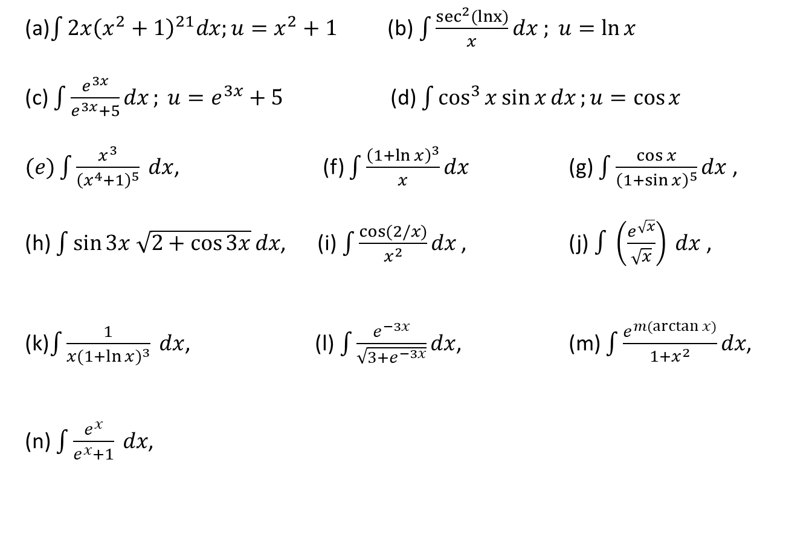
Exercise set-1.1.4
(a)$\int{2x{\left(x^{2}+1\right)}^{21}dx;u=x^{2}+1}$ (b)$\int{\frac{\sec^{2}(lnx)}{x}}dx ; u=\ln{x}$
(c) $\int{\frac{e^{3x}}{e^{3x}+5}dx}; u=e^{3x}+5$ (d) $\int{\cos^{3}{x}\sin{x}dx};u=\cos{x}$
$(e)\int{\frac{x^{3}}{{\left(x^{4}+1\right)}^{5}} dx}$, (f) $\int{\frac{{\left(1+\ln{x}\right)}^{3}}{x}dx}$ (g) $\int{\frac{\cos{x}}{{\left(1+\sin{x}\right)}^{5}}dx}$ ,
(h) $\int{\sin{3x \sqrt{2+\cos{3x}}}dx}$, (i)$\int{\frac{\cos{(2/x)}}{x^{2}}dx}$ , (j)$∫\left(\frac{e^{\sqrt{x}}}{\sqrt{x}}\right) dx$,
(k)$\int{\frac{1}{x{(1+\ln{x})}^{3}} dx}$, (l) $\int{\frac{e^{−3x}}{\sqrt{3+e^{−3x}}}dx}$, (m) $\int{\frac{e^{m(\arctan{x)}}}{1+x^{2}}}dx$,
(n) $\int{\frac{e^{x}}{e^{x}+1} dx}$,
.
Calculus– James Stewart - 8th edition
P-418 Ex # 7 - 13, 15, 18, 20, 21, 27, 31, 32, 43.

